Slide 1
Riesgos de la industria minera
2015-16
  Julio 2015
  María Javiera Contreras
  Líder de Industria Minera de EY
  Alejandra Medina
  Líder Consultoría en Sostenbilidad de EY

Slide 2
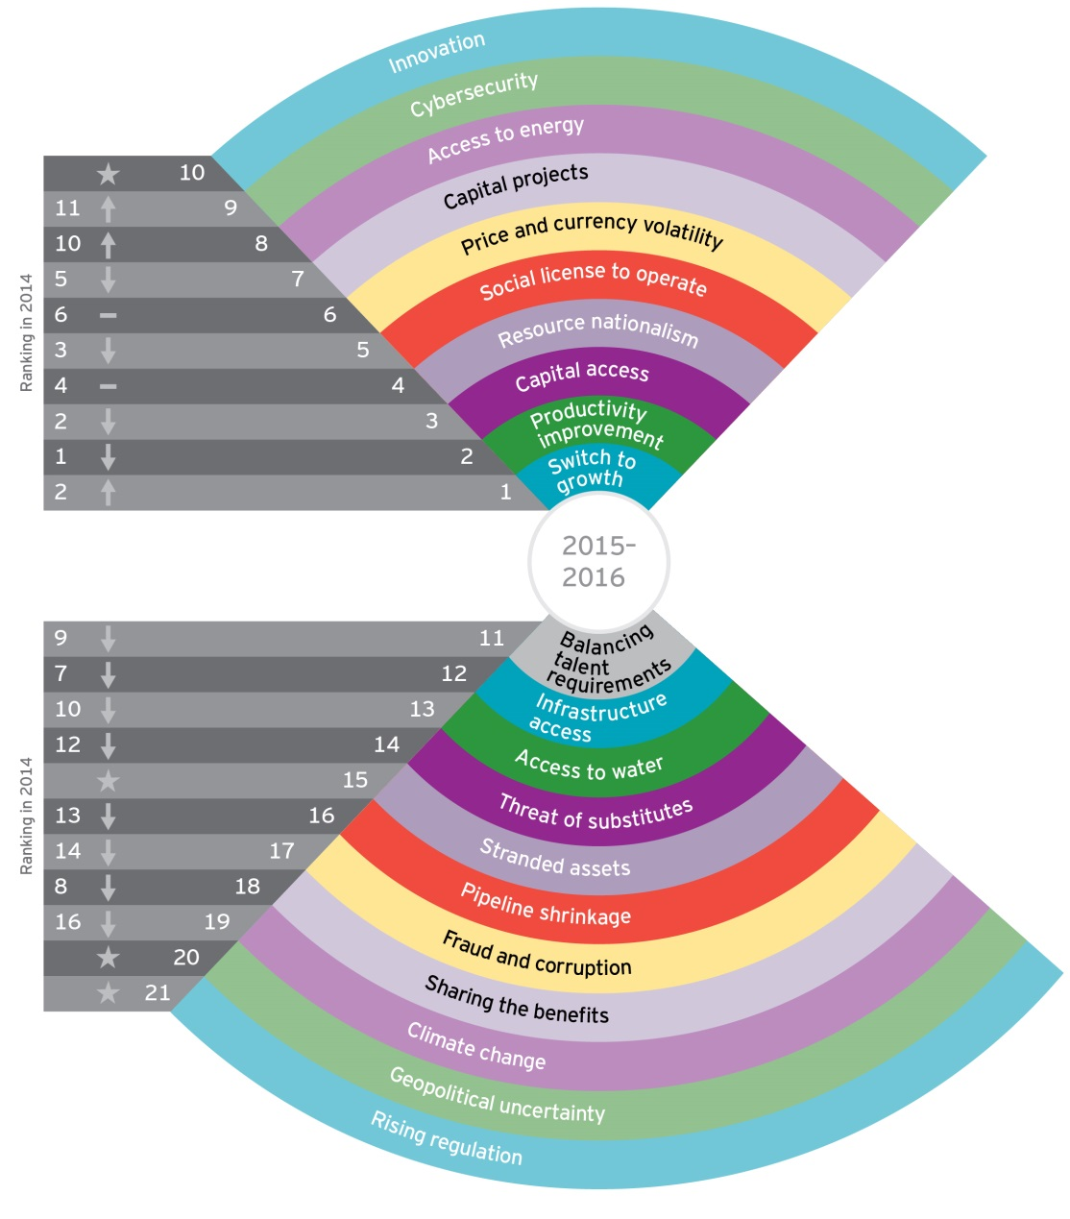
Risk radar
Notes:
Que riesgos se mantuvieron
Los top 3 son los mismos..solo que hoy esta liderado por Crecimiento
Cuales son los nuevos
Cyberseguridad
Inovacion
Que riesgos que estan fueran de los top 10 quizas estarian incluidos si analizaramos solo Chile?
Acceso al agua?
Infraestructura? Carreteras/ caminos
Una baja en el pipeline?? Exploracion
Sharing benefits?? Durante la baja del ciclo quizas es aun mas importante el balance entre las expectativas del gobierno, los trabajadores y la comunidad con los de los accionistas../ Reforma laboral
Sharing de benefits?? Estaba 8 el año pasado

Slide 3
1. Crecimiento
Notes:
En la industria minera por cada tonelada explotada se pierde valor. El enfoque pro ciclo y corto placista es hoy la tonica del colectivo minero.
Quedarse quietos no es una opcion..
Analizar hoy las opciones de crecimiento: comprar o construir es critico, elegir requiere tener un entendimiento cabal del mercado ( oferta global, desarrollo geopolitico, demanda etc) y de la competencia

Slide 4
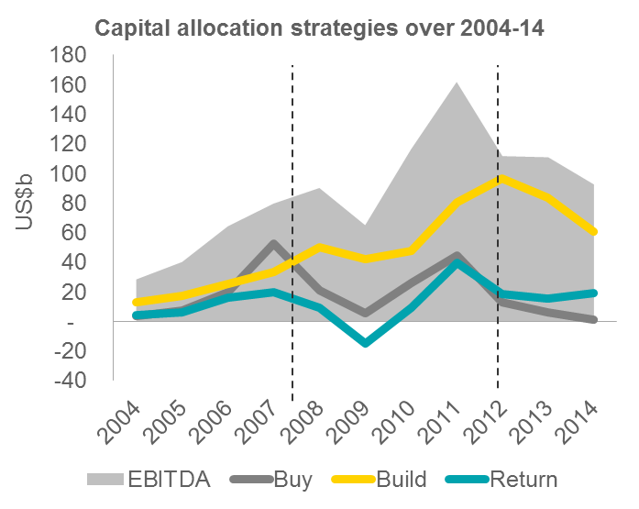
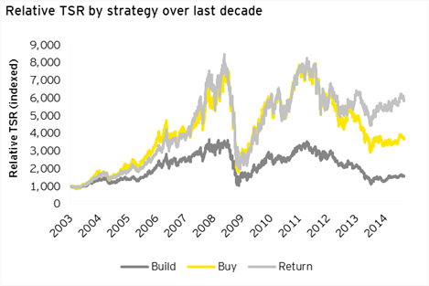
La era de la austeridad de capital
Contracción en las carteras de proyectos
Disminución del crecimiento de volumen
Competencia nueva
Costo de oportunidad de no adquirir en el punto bajo del mercado
Notes:
Scale of investment into organic and inorganic growth at the peak of the last cycle by industry’s top companies
Volume growth at any cost at a time of high-to-peak equity valuations
Subsequent impact on value creation as the cycle turned is evident in total shareholder returns – especially measured by ROCE
Major obstacle to breaking the pattern – investors’ demands for healthier near-term returns with a risk-adverse short-term focus.
En la baja del ciclo la tonica ha sido, reduccion de capex, cierre de minas, ventas de activos non core.productividad... En que momento deben las empresas cambiar el foco y volcar la estrategia hacia el crecimiento??? Quienes se preparan para el contra ciclo??
Algunas consecuencias del enfoque pro ciclo:
Contraccion en la cartera de proyectos: una reduccion drastica de la inversion en exploracion durante los años 2013-14 prepara el terreno para una baja en la oferta de los commoditiies y sigue generando el clasico ciclo de aumento y baja
Disminucion del crecimiento de volumen: Los perfiles de produccion de los actores principales se estiman a la baja despues de 2016 dada por el envejecimiento de las minas y la disminucion del grado de mineral lo que genera la pregunta de como podran cumplir con las expectativas de crecimiento en el mediano y largo plazo si se continua con la reduccion de inversion en capex y venta de activos con el fin de entregar retornos hoy a los accionistas.
Competencia nueva: nuevos compradores estan enfocados en dejar su marca en la industria. Fondos de inversion privado y traders de commodoties pueden estar en una mejor posicion para realizar inversion contraciciliclas sin estar bajo la lupa y la resistencia de accionistas publicos. Puede que estos nuevos actores tengan la suficiente fortaleza fiannciera y experiencia en la industria para convertirse en en propietarios de operaciones importnates y/o estrategicas.
Costo oportunidad: la mayoria de las organizaciones estan enfocadas disminuir los activos que no sean esenciales pero se arriesgan a perder la oportunidad de adquirir activos sub valuados que esten cerca de estar operativos que hoy se encuentran en el mercado a su valor mas bajo.

Slide 5
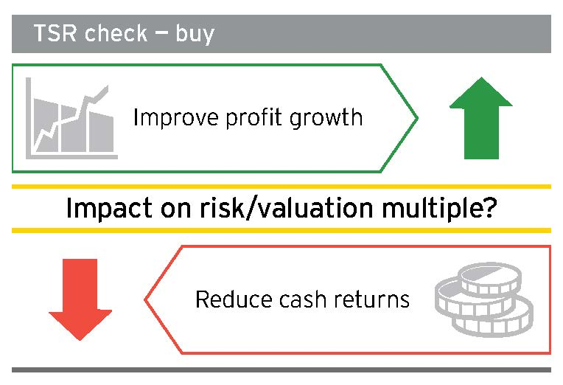
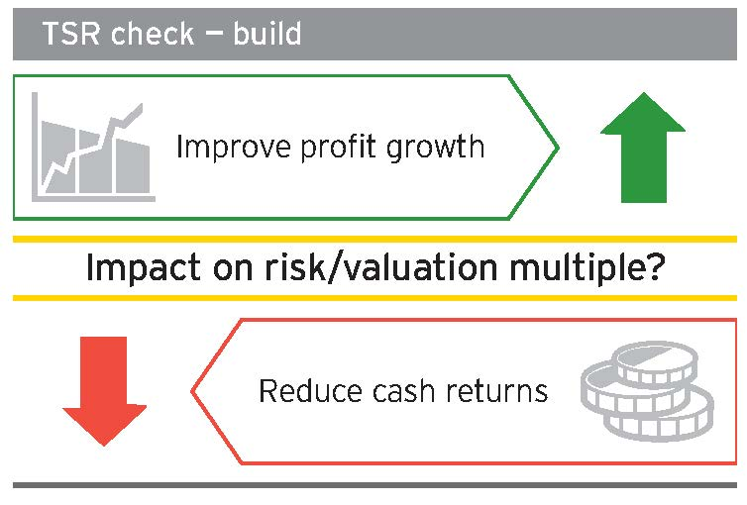
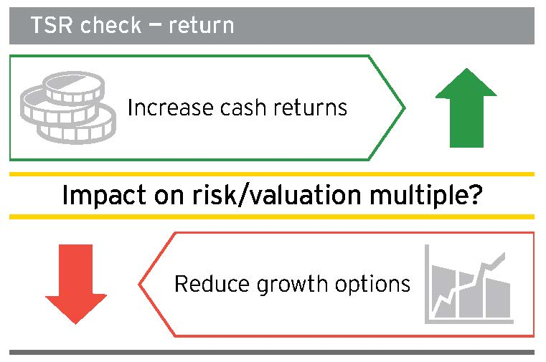
Rompiendo el ciclo – comprar, construir o retornar
La decisión de “comprar” es valiente en este mercado -
requiere de una evaluación rigurosa de todas las opciones para capital
inmovilizarse no es una opción. La aversión al riesgo y la disciplina de capital han obstaculizado la disponibilidad y el gasto del capital para “construir”
Las inversionistas están exigiendo mayores "retornos" en efectivo - esto tiene implicancias para los accionistas de largo plazo
Notes:
Hoy las compañías se enfrentan a una decision dificil, donde asigno el capital y como genero valor? Llevandolo a lo mas simple las opciones son : compro, construyo o retorno , esto en el contexto de balancear necesidades corto y la generacion de valor al largo plazo.
Esto se complica aun mas con la resistencia de los accionistas y proveedores de capital a apoyar o financiar inversiones en crecimiento en una industria que debe invertir con años de anticipacion a la produccion, con tantos factores que escapan el control de la administracion.
Inmovilizarse NO es una opcion. El crecimiento es critico para la industria, que destruye valor si el pipeline de proyectos no se actualiza.
While risk appetites may vary over the commodity price cycle, the investment horizon of mining and metals is still long-term, and pro-cyclical behaviour will lower long-term returns. Demand continues to grow even while supply begins to decline in a few years.
El precio por si solo no va a asegurar el crecimiento…Growth today is fraught with risk and tension. In an era of slower and lower global economic growth, it is likely that company-specific catalysts rather than commodity prices will drive upside share price performance. Companies must work much harder for growth this time around, no longer able to rely on rapid and extreme demand-driven price rises.
Para que las empresas puedan re-enfocarse exitosamente en el crecimiento debe demostrar tener su gestion interna en orden, asegurar que su operacion y estrategia son rescilientes y flexibles como para adaptarse rapidamente a los cambios en el mercado y que son capaces de operar a traves de los ciclos con sus accionistas alineados.

Slide 6
Evaluando las opciones
Consolidar la ventaja competitiva – centrarse en las fortalezas existentes
Adquirir ventaja competitiva – impulsar el rendimiento a largo plazo a través de la adquisición de activos y capacidades
Determinar el momento oportuno – ahora es el momento para comenzar el viaje hacia el crecimiento
Notes:
You need to have a clear understanding and evaluation of the growth options available and their potential impact on the overall business and its strategic direction, need to be established
Consolidating competitive advantage: Playing to existing strengths is the one clear strategy dominating the industry at the moment, as the major iron ore producers exploit their competitive cost positions through volume increases to push higher cost supply out of the market. Understanding and exploiting and effectively executing on unique capabilities or opportunities can help to expedite a risk-managed growth journey
Possibilities include:
Exploiting a unique value proposition to create or unlock value in an acquisition that the current owners are unable to
Consolidating market share through lower-risk, noncompetitive acquisitions in safe jurisdictions or locations in proximity to existing projects, in order to lower costs, enhance volume growth and improve access to capital
Identifying opportunities to improve project economics and reduce execution risks
Acquiring competitive advantage: Regular portfolio review is essential for understanding the current strengths and gaps in relation to the company’s growth strategy. Management should also start to think longer term about how to drive performance and growth through the acquisition of assets and capabilities that don’t already exist in the portfolio. Examples could include:
• Change of commodity, product or geographic focus to diversify or minimize risk exposure
• Joint ventures with strategic partners that bring something extra to the table, such as unique synergies, technological capabilities, marketing relationships, infrastructure access and capital
• Access to capital — partnerships with long-term investors that have a mutual interest in achieving the company’s objectives, offer a relatively stable source of capital, and can bring additional value such as industry expertise, government relationships or advice on issues surrounding social license to operate
• Acquisition of value-add downstream capabilities, or collaboration with consumer sectors, to optimize products and gain competitive advantage through evolution and provision of supply to emerging technologies
• Acquisition of new businesses that transform the business model or supply chain — for example, integration of trading capabilities
• Acquisition of technologies to improve project economics and productivity, or open up access to previously impenetrable geographies or geologies
• Low-risk, cost-minimized investing in prospective greenfield projects today, so that investment decisions are possible by 2016 and beyond,
Determining the opportune timing It is clear that (a) preparation is critical and (b) timing is a game of pure chance or guesswork without that preparation in place. Without solid foundations, market awareness and shareholder support, companies will be unable to successfully capitalize on unique market opportunities as they present themselves.
Now is the time to begin that growth journey — to prepare the organization, its operations and its stakeholders, to reset minds on long-term growth, and to build a business that is more sustainable, resilient and profitable throughout economic cycles.

Slide 7
2. Productividad

Slide 8
La productividad cayó dramáticamente durante el súper ciclo
La productividad cayo a su menor grado en los ultimos 30 años durante el super ciclo
Son cuatro las areas que lideraron esta baja:
  RRHH: durante el super ciclo se aumetaron las contrataciones de personal sin experiencia
  Productividad del capital: la tasa promedio es de 62% sobre presupuesto, un 50% de los proyectos estan con demora
  Materiales: reservas y grados de mineral a la baja
  Economias de escala: Los niveles de productividad tambien bajan dada la complejidad de manejar proyectos de escala siginificativamente superiores.
Notes:
You need to have a clear understanding and evaluation of the growth options available and their potential impact on the overall business and its strategic direction, need to be established
Consolidating competitive advantage: Playing to existing strengths is the one clear strategy dominating the industry at the moment, as the major iron ore producers exploit their competitive cost positions through volume increases to push higher cost supply out of the market. Understanding and exploiting and effectively executing on unique capabilities or opportunities can help to expedite a risk-managed growth journey
Possibilities include:
Exploiting a unique value proposition to create or unlock value in an acquisition that the current owners are unable to
Consolidating market share through lower-risk, noncompetitive acquisitions in safe jurisdictions or locations in proximity to existing projects, in order to lower costs, enhance volume growth and improve access to capital
Identifying opportunities to improve project economics and reduce execution risks
Acquiring competitive advantage: Regular portfolio review is essential for understanding the current strengths and gaps in relation to the company’s growth strategy. Management should also start to think longer term about how to drive performance and growth through the acquisition of assets and capabilities that don’t already exist in the portfolio. Examples could include:
• Change of commodity, product or geographic focus to diversify or minimize risk exposure
• Joint ventures with strategic partners that bring something extra to the table, such as unique synergies, technological capabilities, marketing relationships, infrastructure access and capital
• Access to capital — partnerships with long-term investors that have a mutual interest in achieving the company’s objectives, offer a relatively stable source of capital, and can bring additional value such as industry expertise, government relationships or advice on issues surrounding social license to operate
• Acquisition of value-add downstream capabilities, or collaboration with consumer sectors, to optimize products and gain competitive advantage through evolution and provision of supply to emerging technologies
• Acquisition of new businesses that transform the business model or supply chain — for example, integration of trading capabilities
• Acquisition of technologies to improve project economics and productivity, or open up access to previously impenetrable geographies or geologies
• Low-risk, cost-minimized investing in prospective greenfield projects today, so that investment decisions are possible by 2016 and beyond,
Determining the opportune timing It is clear that (a) preparation is critical and (b) timing is a game of pure chance or guesswork without that preparation in place. Without solid foundations, market awareness and shareholder support, companies will be unable to successfully capitalize on unique market opportunities as they present themselves.
Now is the time to begin that growth journey — to prepare the organization, its operations and its stakeholders, to reset minds on long-term growth, and to build a business that is more sustainable, resilient and profitable throughout economic cycles.

Slide 9
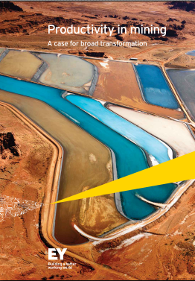

El desafio de la productividad
“Las cosas se han hecho más grandes, pero no necesariamente mejores”
EY opina:
Un aumento real en la productividad solo vendrá con una transformación de principio a fin
Un enfoque centrado en soluciones puntuales o la mejora continua no cerrará la brecha e incluso podría ser contraproducente
Las empresas que han mejorado su productividad tienen las siguientes características:
Abordan el tema con un enfoque de principio a fin
Aprenden de la historia
Abiertos a la innovación
Abordan los ajustes conductuales para la sustentabilidad
Miden lo que importa para el margen
June 2015
Business risks facing mining & metals 2015-16
Notes:
A narrow focus on point solutions or continuous improvement will not close the productivity gap sufficiently, and may even be counterproductive. Real productivity gains will only come from end-to-end transformation.
Having reached a ceiling on cost reduction, mining companies have since made substantial progress with their productivity initiatives and working capital solutions

Slide 10
El progreso a la fecha ha sido considerable
Reducción de costos
Productividad
Capital de trabajo
“
“
“
Mayores volúmenes en la mayoría del portafolio, con una reducción de costos de 2% en términos reales.
Anglo American
Hemos superado nuestras metas de reducción de costos, con una mejora sustentable de US$3,2 mil millones en los costos operativos”.
Rio Tinto
Implementamos eficiencias impulsadas por la productividad en volumen y costos de US$2.9 mil millones, superando nuestra meta en un 61%.
BHP Billiton
Nos hemos centrado en aumentar la productividad y optimizar el uso de equipos para garantizar el más alto nivel de eficiencia”.
Antofagasta Minerals
En los últmos dos años, hemos liberado US$2.1 mil millones en capital de trabajo.
Rio Tinto
Alcoa ha reducido el promedio de días de capital de trabajo por 9 días desde el 2009.
Alcoa
Estamos liberando capital de trabajo mediante la reducción de los inventarios”.
Barrick Gold
June 2015
Business risks facing mining & metals 2015-16
Notes:
More needs to be done to ensure that each element in the business, from the resource in the ground to the product being delivered to clients is optimized — not on its own, but as part of a business system.

Slide 11
Las empresas mineras exitosas en la mejora de su productividad
Abordan el tema con un enfoque de principio a fin
Aprenden de la historia y activamente contratan trabajadores quienes han operado en un ambiente de costos limitados
Son abiertos a la innovación y están invirtiendo en ella
Abordan el cambio cultural necesario para fomentar un enfoque en la productividad
Manejan la información de sus sistemas de IT /OT para saber que significa la buena productividad y están midiendo el desempeño de acuerdo a ello
Se están centrando en la productividad a largo plazo
June 2015
Business risks facing mining & metals 2015-16
Notes:
The current focus on productivity is bottom-line driven to maximize revenue and minimize cost in a low-price environment.
Mining companies need to ensure that their investment in productivity isn’t deprioritized once commodity prices improve
They need to take a longer-term focus, sustained productivity levels can help to optimize capital
When making acquisitions or divestments mining companies need to consider productivity as a part of synergies
Productivity improvement can be a source of competitive advantage for early adopters
Mining and metals companies which choose to seriously innovate will drive superior performance for the next mining and metals cycle.

Slide 12
3. Acceso al capital

Slide 13
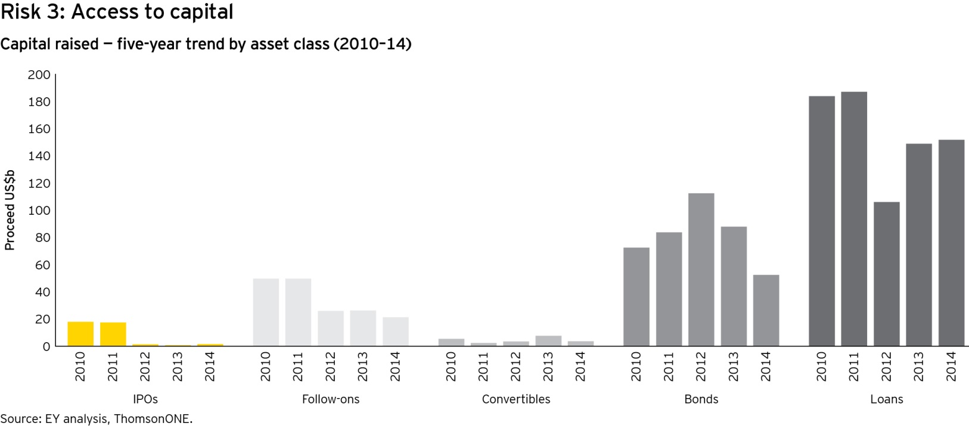
Acceso al capital: mercados nerviosos
Los inversionistas institucionales son adversos al riesgo y son altamente selectivos
Fondos con apetito por el retorno están en busca de proyectos con problemas de financiamiento
Los juniors luchan por acceder al capital
Poco capital disponible para el desarrollo y exploración de mayor riesgo
Impacto en la futura oferta
June 2015
Business risks facing mining & metals 2015-16
Notes:
The industry has entered an historic period of correction to adjust oversupply. This is impacting earnings, balance sheets and investor perceptions.
Producers are focused on restoring stretched balance sheets and improving profitability through asset sales and capex reductions
Distressed mid-tiers are restructuring debt
Juniors are struggling to access the equity needed to sustain their activities
Retail investors are all-but-absent from the sector
Institutional investors are largely risk averse and highly selective
Yield-hungry funds are increasingly on the lookout for distressed debt opportunities.
This has impacted the amount of capital raised by the industry:
Total proceeds down 15% y-o-y in 2014,
Equity raised by the global junior sector has fallen year-on-year since 2012 - over half of issues by junior companies in 2014 raised less than $1m.
Around a third of those companies returned to the market at least once more within 12 months to raise additional funds – some as many as 6-8 times.
Of the US$152b of bank debt raised by the sector, just US$22b (15%) was specifically for project finance
While favorable windows have opened in the equity markets – for example, for Toronto-listed gold companies in early 2015 following a brief uplift in the gold price - such windows are typically open only for short periods of time in the current volatile environment.
In the debt markets, nearly US$75b of refinancing by larger producers accounted for 49% of loan proceeds, pointing to continued demand and liquidity for strong names. But lenders’ tolerance of risk has its limits in this environment
Fortescue Metals Group abandoned a US$2.5b refinancing attempt in March (subsequently launching a US$2.3b offering in April, underlining the fickle nature of the markets)
Murray Energy downsized the scale of its acquisition of Foresight Energy, reportedly due to challenging conditions in the debt markets.,

Slide 14
El aumento de los riesgos y la complejidad
Financiamiento alternativo - una bendición para las empresas que lo necesitan, pero también una fuente de aumento de los riesgos
Alternativas limitadas para los juniors – aceptar las opciones, o correr el riesgo del estancamiento del proyecto, la pérdida de posicionamiento competitivo y la pérdida de propiedad
Componentes múltiples
Streaming- flujos
Capital
Acuerdo Offtake de pre-financiamiento
Créditos puente
Deuda de alto rendimiento
Bono convertible
Proveedores múltiples
Capital privado
Compradores Offtake
Bancos de desarrollo
Bancos nacionales
Gobiernos
Mercados de capital
Riesgos multiplicados
Dilución de ingresos futuros
Posibilidad de financiamiento futura
Interdependencia
Costos altos
Exposición de crédito
June 2015
Business risks facing mining & metals 2015-16
Notes:
The market conditions have facilitated the rise of alternative sources of finance
But faced with limited choice, companies are often accepting terms that may be expensive to arrange and maintain (potentially beyond their means in a deteriorating market), dilutive to future earnings, present loss of control and damaging to future financing prospects.
Private capital investors have pointed to stream agreements, for example, as an impediment to their willingness to invest, due to the loss of upside potential, the dilutive effect and the complexity involved in unwinding such structures.
With capital providers reluctant to “spend big,” companies need to approach multiple providers to secure sufficient funds, increasing the complexity and costs of arranging finance.
Survival is a strong motivation of many juniors in but this can create excessive short-term action that may cumber the value of the asset or project indefinitely.
Leverage also remains a key concern, particularly in the iron ore and coal sectors
Little prospect of near-term turnaround for smaller, higher cost producers,
Cumulative US$14b of debt maturing in the next three years in the relatively small US high yield sector alone
Investors are pricing risk at a premium in 2015 – coal and iron ore issuers CONSOL Energy, Peabody Energy and Cliffs Natural Resources paid a weighted-average coupon of 8.8% in Q1 2015, compared with a sector average of 7.5% in 2014.
Conditions are arguably ripe in certain sectors of the industry for distressed debt hedge funds looking to take advantage of “buy to own” opportunities; a number of US coal companies are said to be the targets of such interest.
Private capital firms are increasingly seeing good investment opportunities but are more likely to prioritize producing assets. As such, private capital is unlikely to be a major source of capital for junior explorers.

Slide 15
Es el momento de un enfoque estratégico
La preparación, el conocimiento, y la planificación
  Centrarse en objetivos estratégicos a largo plazo
  Entender implicancias del financiamiento en el corto y largo plazo
  Considerar alternativas de mitigación de riesgo
Conocimiento del mercado
  Es necesario estar preparados- documentacion lista
  Aprovechar las ventanas de confianza del mercado y asegurar financiamiento/ extender o modificar los acuerdos en mejores terminos
Percepcion del inversionista
  Atraer al inversionista “correcto” requiere claridad en como se enfrentarán los riesgos inherentes a un negocio de largo plazo
Desinversión existosa- evitar dejar valor arriba de la mesa
June 2015
Business risks facing mining & metals 2015-16
Notes:
Preparation, knowledge and planning:
Maintain a focus on the longer-term strategic aims of project fundraising in order to meet both short-term and long-term needs as the project progresses through its various stages.
Requires a thorough understanding of:
Short- and long-term implications of different funding structures
Means with which to mitigate risk – e.g., inter-creditor principles and debt headroom into contracts; minimizing future earnings dilution.
Default risks – requires a conservative approach to the economic assumptions used in feasibility studies and a proactive approach to refinancing.
Pros and cons of different funding structures from a valuation, risk and tax perspective
Market awareness:
Have documentation and strategic aims in place
Keep a keen eye on the market in order to successfully capitalize on windows of investor confidence and secure or “extend and amend” finance on attractive terms
Investor perception:
Yield continues to be a short-term driver of demand in capital markets, but mining companies are long-term investments, requiring long-term financing partners. Attracting the “right” kind of investor requires clear and realistic articulation of how inherent risks will be managed and mitigated throughout the life of the proposed investment.
Successful divesting: maximize value and speed of execution to avoid leaving value on the table. E.g., through:
Regular portfolio review
Rigorous preparation
A story targeted to individual buyers
Effective separation planning
(see EY’s Global Corporate Divestment Study)

Slide 16
4. Nacionalización de recursos

Slide 17
Nacionalización de recursos
Sigue la percepción de que las empresas de minería no pagan su participación justa, o que tampoco contribuyen suficientemente en las comunidades donde operan
¿Qué causa este problema?
Por otro lado, el período económico débil resulta en que los Gobiernos buscan más o nuevas fuentes de ingresos
Impuestos y royalties aumentan
La propiedad estatal
Uganda
Anular los impuestos de exploración
Cambiar las normas ambientales
Eliminación del royalty de diamantes
La iniciativa del desarrollo de exploración
La promulgación de la ley progresiva de minería
Los gobiernos buscan atraer la inversión minera
Chile
Existe la percepción de que las empresas de minería no pagan su participación justa.
Zimbabwe
Úselo o piérdalo
Beneficio mandato
Australia
Kenia
Los stakeholders exigen una transparencia mayor respecto de los pagos a los gobiernos, y sobre dónde se van las ganancias
Esta situación presenta la oportunidad para demostrar sus contribuciones
Notes:
Taxes and royalties are still being increased around the world including India, Guatemala and the Democratic Republic of the Congo
Mandated beneficiation is gaining political popularity with perceived value adds to economies implemented in Indonesia for base metals with proposals in Zimbabwe and discussion in South Africa, Ghana and Namibia
However retreating resource nationalism or investment attraction is gaining pace in light of weaker economic outlooks and Governments looking to increase revenue sources.
Governments are changing laws to encourage capital flows into the sector by improving the investment environment. Countries include Peru, Mongolia and Ecuador
Retreating resource nationalism includes Australia repealing its Minerals Resource Rent Tax on coal and iron ore in 2014 and Zambia returned to a 9% royalty rate and then lowered it further to 6% for underground and open-pit operations (from 20% and 8%, respectively)
However perception miners are taking advantage of countries and not paying their “fair share” has lead to the need for increased transparency in the sector
Extractive industries need to expand the disclosure of payments to governments as a means of reducing corruption by shining a light on these payments
Companies will need to start disclosing annually their government payments on country-by-country and project-by-project bases under publish what you pay rules

Slide 18
Requerimientos de transparencia siguen aumentando
Informes país a país y proyecto a proyecto
Enfoque más sofisticado para la fiscalización por parte de las autoridades
Aumento de intercambio entre autoridades tributarias
Iniciativas de transparencia dentro de la UE y USA (EITI – Iniciativa de transparencia para industrias estractivas, para industrias sujetas a SEC para el 2016)
OCDE – Action 13: 1 enero 2016
Compañías deben preparase para este escenario; revisión de los sistemas de captura de información, acceso a los datos que se requieren, confiabilidad de los datos
Oportunidad para comunicar mejor la constribución de la minerías a los países donde operan
June 2015
Business risks facing mining & metals 2015-16
Notes:
BEPS / Country by Country Reporting
Tax authorities sharing information and taking a more sophisticated approach to audits
Tax issues becoming more common in the media (e.g. Starbucks in the UK)
EU transparency initiatives
Accelerating rate of law changes and court cases
Stricter auditing standards and EU audit reform
FCPA and similar rules in many counties
Navigating a country’s economic and political issues — More “scrutiny” on US companies operating certain countries (e,g. Venezuela, Russia, China)

Slide 19
5. Licencia social para operar

Slide 20
Licencia social para operar
Pasado
Una pobre LSPO puede matar un proyecto
Valor = 0
Una licencia social para operar pobre ha resultado en atrasos de proyectos y pérdida de valor
Presente
“La licencia social para operar es una colaboración, no un trade-off
June 2015
Business risks facing mining & metals 2015-16
Notes:
Mining and metals operations and the community are inseparable
Despite the tough economic it is “false savings” to cut back on community engagements just because exploration spending has slowed
It is proven that early and consistent community engagement and investment is more valuable to project than a increase in spending postfeasibility.

Slide 21
Rango dinámico de grupos de interés
  ……….con demandas crecientes y el poder para detener proyectos
Comunidades
locales
ONG &
Activistas
Empleados
Clientes
Inversionistas
Proveedores
Gobiernos
Cuerpos
regulatorios
Comunidades
digitales
  La necesidad para determinar un valor social medible de los proyectos
Notes:
Influential groups not traditionally considered stakeholders are mounting concerns about mining – e.g. Climate change activists.
Stakeholders and their concerns/attitudes are changing quickly
Understanding of environmental and social impacts has broadened.
Investors and customers are increasingly influential in SLTO
Ethical investing is on the rise
Disclosure of upstream business relationships and conflict minerals to distance from human rights abuses.
Customers interested in ethically and sustainably sourced goods.
Risk in not obtaining acceptance by anyone of your stakeholder groups includes:
lost potential investment streams,
supply chain and customer base challenges,
reputational damage.

Slide 22
Licencia social para operar – la comunidad protesta en América Latina
Cananea
Rancho Grande
Cauca
Minas Conga
Carajás
Tia Maria
Cochabamba
Pascua Lama
Los Pelambres
Notes:
“The fight over the mining law is part of a much wider conflict across the Andes and Latin America.
Who profits from the extraction of natural resources?
Who pays when mining or oil exploration harms the environment and local communities?
To what extent are local communities consulted about resource extraction that destroys their land, water, and livelihoods?”
Protests appear largely directed at the policies/actions of the governments rather than at the miners themselves (???)
EG. in Peru.
- Estimated that $57b of projects in Peru alone may not materialise due to social conflict and unrest triggered by opposition to extractive projects, despite pro-mining policies by the governments.
149 conflicts reports in 2014.
Government increasingly militant in it’s repression of violence, potentially fueling the resistance and causing repuational damage to companies trying to operate in the region. Particularly opposed to illegal mining.
Some samples of conflicts in latinAmerica in recent years
Pascua-Lama (Chile)
- Mothballed in Jul 2014, after spending $5b developing the projects. Various challenges, including from Chilean indigenous communities concerned about water supply
Los Pelambres (Chile)
- Villagers blocked access to Antofagasta copper mine dam in November 2014, claiming pollutes the village’s water supply and poses an environmental threat in case of flooding or an earthquake. Politically, Chiles committed to tackling inequality and is demanding higher standards from mine owners.
Tia Maria (Peru)
- $1.4b copper project. Ongoing clashes since 2009 with community concerns that the mine will damage environment and ruin agriculture in the area, despite approved for compliance with high environmental standards. Three people have dies recently. Troops have bee deployed.
Minas Conga (Peru)
- $4.8b project of Yanacocha (Newmont, Buenaventura, IFC) in Cajamarca region. Violent protests in 2011 over fears the project would pollute and drain local water supply. Opposition too by local politician, recently re-elected.
Cauca (Colombia)
- Local protests against illegal miners who are accused of causing damage to human and livestock health, plus environment. Cauca, traditionally a farming and mining, has seen in recent years a steep increase in illegal mining activities controlled by criminal gangs and guerrillas.
Rancho Grande (Nicaragua)
- B2Gold. Since 2004, Canadian mining companies in cooperation with Nicaraguan enterprises have explored for gold in this area. For four years, successive mining companies have tried to buy up land in the area, while the ranchers, coffee growers and small farmers struggled to keep them from their land.
Cochabamba (Bolivia)
- Multi-faceted protests. In April 2014, protest (and hostages) by miners against new policy to give government oversight of private mining transactions.
Carajas (Brazil)
- Brazilian indigenous people in the Amazon region have blocked one of the country's most important railways in a protest for better public services. They actually wanted Vale to act on their behalf in negotiations with the authorities
Amazon (Brazil)
- Historically, conflict between preserving indigenous culture and protection of the rainforest against promoting economic development. Indians across Brazil say non-indigenous presence in their territories threatens their safety and unique culture, access to ancestral lands.
Cananea (Mexico)
- Occupation of town over dangerous working conditions. Government has introduced force. Miners have been joined by local farmers in their protest, angry over toxic spill into the Sonora River in August 2014 that is causing health problems and economic devestation.

Slide 23
Licencia social para operar
El activismo es cada vez más político, de escala nacional, y judicial
Conciencia mas fuerte del valor cultural/económico de la tierra, tanto de las comunidades como de las empresas
Tendencias de regular la licencia social para operar – Chile: Regulación ambiental, Paricipacion ciudadada temprana y formal, Acuerdos voluntarios de preinversión (Consejo Nacional de Producción Limpia), operatividad del Convenio 169 y la consulta indígena anuncio del Ministerio Indígena
Compartir beneficios y también riesgos en tiempos difíciles. Falso ahorro dismuir presupuestos de relacion con la comunidad en tiempos economicamente duros; invertir temprana y consistentemente es más valioso para el proyecto que el gasto en viabilizar un proyecto después.
La representatividad y la necesidad de realizar consultas ciudadanas amplias e inclusivas
La importancia de establecer una relación temprana, permanente y profunda más allá de la normativa básica, es esencial
Notes:
Miners need to bring communities along with them in prosperous time, but acknowledge they share in downside risks too
Lower commodity price mean exploration budgets being cut, impacting developing regions reliant on foreign investment.
Natural disasters, biohazards eg. Ebola. Miners considered closing operations.
Potential cuts to important environmental health and safety.
Negative sentiment towards miners who “abandon them”.
Indirect impact on affiliate industries, local services etc.
Governments getting involved in community/social
Examples where policies or actions by governments pro-mining/foreign investment but meeting conflict with local industries, artisanal miners, etc.
Also an opposite eg. in Greece where community protested against closure on environmental grounds because of county’s economic condition.
Some governments becoming militant in suppression of protests, leading to negative impact on miners operating in the region.
Likelihood of increased regulation and regulation in some regions (eg. Canada).
Activist increasing litigious and combining forces.
Lengthly legal battles and can cause reputational damage.
Coalition of groups, eg. environmentalists, indigenous groups, other industries to oppose mine. Eg. Lock the Gate.
Access to information and means to consult more widely means greater awareness of value of land.
Some governments now recognising FPIC of communities to make final decision on whether a mine is approved or not.
Eg. Text message referendum in Mongolia. Eg. Bouganville Mining Act 2015.

Slide 24
6. Volatilidad de precios de commodities

Slide 25
Outlook
Precio y volatilidad de la moneda continuará hasta 2017 – debido a:
El nivel de corrección requerido
Un aumento de regulaciones, especialmente respecto al beneficio mandato
La debilidad adicional de política monetaria en Europa y Japón
Aumento de riesgo geopolítico en Medio Oriente, África de Norte, y Europa Oriental
Empresas estatales de minería y metales que subvencionan operaciones deficitarias
Desarrollo continuo de ofertas de financiamiento asegurado por las explotaciones de metales físicos
Inversión baja en la exploración y desarrollo
Notes:
A less known factor that may impact is the future outlook for demand, if real Chinese metal demand growth were to slow or even decline, this could further compound an already volatile market. The uncertainty created will also increase volatility.

Slide 26
Respuestas a la volatilidad
La reducción de costos – muy poco efectiva. “Estan todos en la misma”.
Mejorar la productividad y por ende mejorar el rendimiento en la curva de los costos
Cobertura (Hedging) – pero considerando ambas partes de la volatilidad
Mejorar la flexibilidad de las operaciones de minería y metales – intercambiar los costos variables por costos fijos
Notes:
Initial to improve relative position on the cost curve but ineffective as most producers have adopted the same reduction, maintaining the same position relatively on the cost curve, lowering the marginal cost of production, and thereby lowering prices even further.
Few made up for loss of productivity over the super-cycle, but those who have, have improved their cost curve performance.
Hedging also used either voluntarily or as part of financing arrangements
But due to the link between currency and price any hedging program must considers both parts of volatility

Slide 27
6. Capital projects

Slide 28
Estudio EY que muestra que la productividad del capital es normalmente pobre
Un estudio global de 108 proyectos de minería y metales con inversión mayor a $1b encontró que:
69%
Proyectos enfrentan sobrecostos
62%
Es el promedio de sobrecosto de un presupuesto
50%
Atrasados a pesar de iniciativas de aceleración correctivas
Los sobrecostos tienen un impacto directo en la productividad del capital, valor a largo plazo, y rendimiento comercial
Notes:
Key issue for CEOs as falling commodity prices and a rising supply surplus are ushering in a period of restraint in capital project investment
Scarce capital is driving a strong focus on capital productivity or “value for money,”
Study identified aggregate cuts in capital expenditure of more than US$27b in the period since January 2012
Mining capital spending is expected to drop by 5% in 2014
Iron ore represented the highest proportion of projects experiencing cost overruns at 73%, with the average cost overrun being 130%

Slide 29
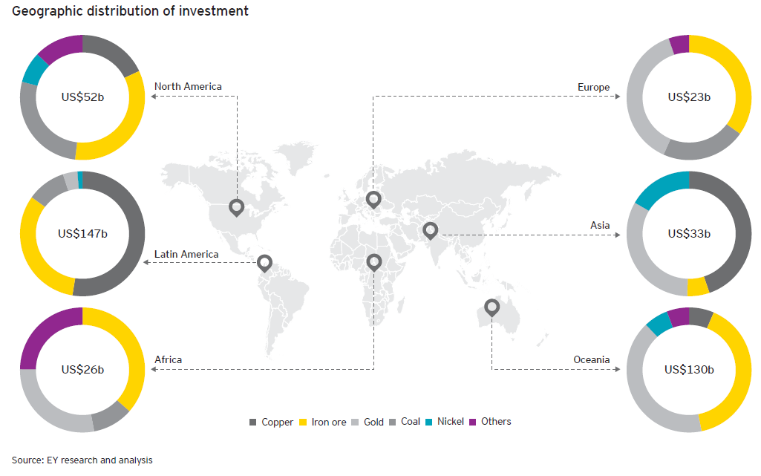
El alcance de megaproyectos
El US$367b representado en el estudio se extendió a nivel mundial
Notes:
Oceania and Latin America reported the highest average budget overruns due to the large amount of investment in projects in these regions occurring concurrently during the boom

Slide 30
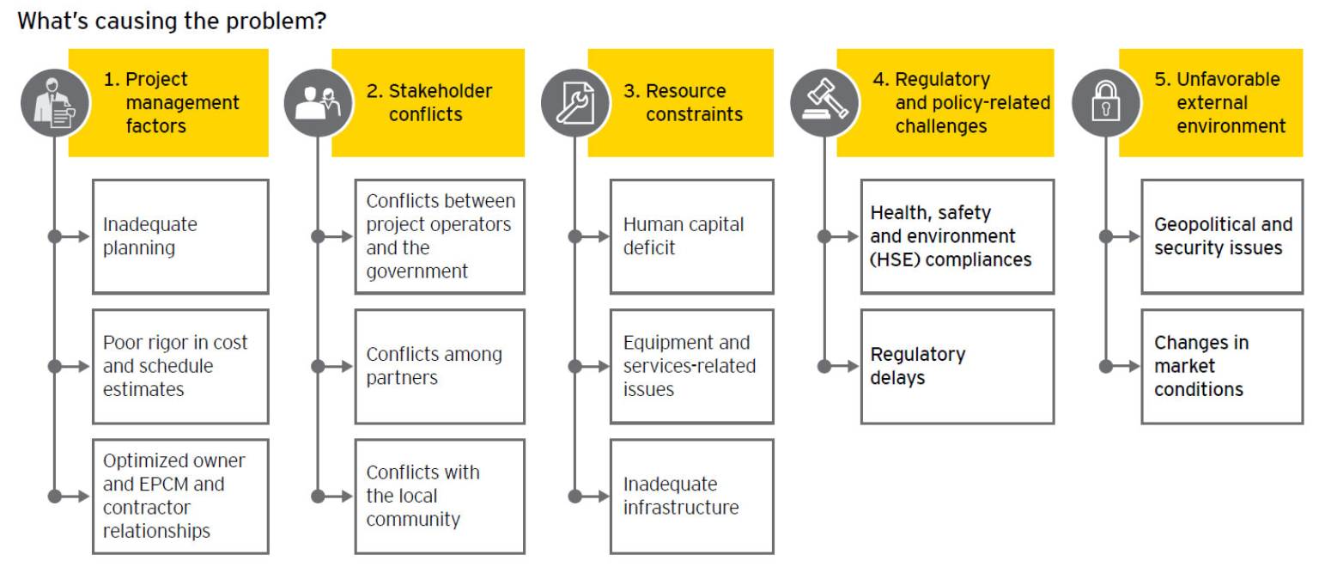
Causas principales de sobrecostos
Basado en nuestro análisis de proyectos de minería y metales, identificamos cinco causas principales de sobrecostos de presupuesto y programación a través de la cartera global actual de inversiones mineras y metalúrgicas
Notes:
There are two key levers for companies to enhance their capital productivity performance:
1. Minimized and predictable “input” through controlled project delivery
2. Maximized and sustainable “output” through earlier asset operationalization (e.g., schedule acceleration) or operational efficiency
Successful capital mining and metals projects drive enhanced capital productivity outcomes by addressing both these levers — “inputs” are controlled and “output” efficiency is designed simultaneously
At-risk capital projects usually are challenged by “input” inflation (such as cost and schedule variance) and compromised “output” performance (such as operational impacts of poor design).
There is a consistent theme of underinvestment and lack of focus in three, often overlooked, but critical areas:
• Implementing governance and reporting frameworks with lead indicators that reliably flag emerging risks while they can still be efficiently mitigated
• Allocating adequate cost and time contingencies to account for risks across a project’s lifecycle
• Enhancing the value of contingency planning by aligning contingency plans to scenario plans

Slide 31
8. Acceso a energía

Slide 32
Riesgo en minería es cada vez mayor por alza de costos y falta de disponibilidad de energía
Desafíos:
El costo y disponibilidad de energía en lugares aislados
La reducción de la huella energética y también las emisiones
La competencia por energía con una clase media creciente
Las redes de transmisión requieren mayor inversión
El impacto de interrupciones imprevistas y desconexión de cargas
Disponibilidad futura de fuentes de energía
La energía constituye hasta 40% de la base total de costo de una compañía
Business risks facing mining & metals 2015-16
Notes:
Rising risk of energy availability as mining and metals companies expand operations to remote areas with under-developed energy infrastructure
Reducing energy footprint and reducing emissions are imperative for the industry’s social license to operate
Competing for energy with other sectors in rapidly developing markets such as Chile and Peru
Mines in emerging countries are located in remote locations and may not have adequate linkages to the transmission grid
Lack of access to energy raw materials (such as coal blocks) to support the self-supply model
E.g.
In Chile electricity costs have increased by 11% a year since 2000, making it one of the most expensive mining regions in terms of securing energy.
Rising residential energy demand combined with underinvestment by utilities in South Africa means a loss of competitive advantage as a low-cost energy location.
The more remote the mine, the more likely off-grid power solutions are required, e.g., the majority of Chile’s mines are located in remote locations at altitude in the north of the country. Much of Chile’s remaining hydro potential is located in the south of the country, far from the mines and the urban centre of Santiago and not currently linked to the transmission network.

Slide 33
Asegurar Energía en el largo plazo
El menor precio del petróleo a significado menores costos en un input importante y en transporte, pero escenario puede revertirse
Se requiere asegurar energía en el largo plazo, de una forma sustentable, costo efectiva e ininterrumpida desde etapas tempranas del proyecto, Chile en particular por el aislamiento de las faenas.
Autoabastecimiento como estrategia, adquisición de empresas de energía
Rol del Estado en infraestructura e incentivos
Innovación: eficiencia energética
Energías renovables; Lugar de Chile en el RECAI (11)
Notes:
Implications of the falling oil price
Lower input costs: energy is a large component of a mines operating costs, up to 40% in some cases. Thus mines will make cost savings directly from lower import costs.
Incentive to hedge: it is unclear how long low prices will last for therefore there is some incentive to miners that are oil dependent to hedge their forward purchases of oil rather than trying to pick the bottom.
Energy producers may surrender the gains: Weakness in oil prices feeds into lower coal, gas and uranium prices. There is direct relationship on gas prices, however as both coal and uranium are over-supplied markets even small amounts of substitution of oil production for thermal coal or nuclear will have a negative impact on the prices of those commodities. While revenue is likely to be weaker they should still benefit from the gains in input cost reductions.
Changes to transportation cost differentials: Energy required to transport bulk commodities are high but proximity can make a difference and can be a significant competitive advantage. A lower oil price rebalances this equation and higher quality product can be shipped further cheaper. Brazilian iron ore producers will hope to reduce Australian producers’ freight advantage to China on a similar basis.
Changes to production methods: Energy can be a serious constraint and if mines can use methods requiring oil over other methods it may change production methods whilst oil prices are low providing further cost savings through energy substitution.
Weaker incentive for alternative energy: High oil costs have driven the adoption of renewable energy. A lower oil price will change that equation for the near term outlook when many of the next round of investment decisions are made.
Provide support of inefficient energy intensive operations: Best practice operators have developed a cost advantage over their competitors by being more energy efficient. However a lower oil price may erode that advantage.
Benefit in energy intensive beneficiation: A lower oil price may improve the commercial merits of locations requiring mandated beneficiation where a natural energy comparative advantage does not exist. This may soften part of the blow in the short term of the rise in the incidence of mandated beneficiation.
Change in mine plans: A lower oil price may help reverse part of the trend of mines shedding “uneconomic reserves”. Such resources impacted by depth or lateral haul distances may now find their way back into life-of-mine plans.
The related currency impact: A number of large mining export nations are also major energy exporting nations including Canada, Colombia, Mexico and Australia. As the oil price has fallen, so have their currencies devalued. Producers in these countries may therefore lose part of the benefit of a lower oil price, as it will not fall as much in local currency terms. However, they will gain an even greater advantage in the value they receive for their products in local currency.

Slide 34
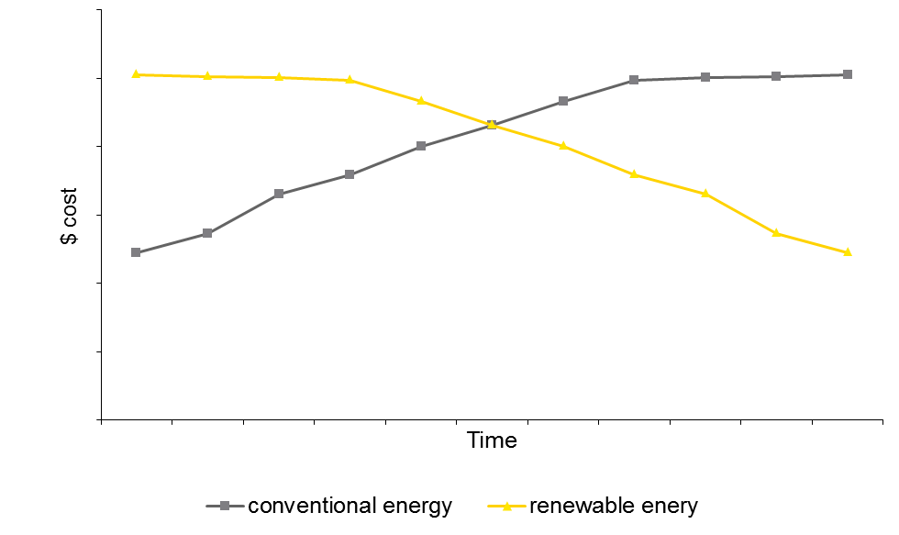
Costos de energía renovable
Atacama
Desert
Notes:
Current prices have dis-incentivized the development of renewable energy sources
However investment in renewable energy can help companies ensure energy safety and also hedge against energy price fluctuations
On-site renewable energy generation, efficiency technologies and micro-grids help companies create a significant cost savings and operational optimization

Slide 35
9. Ciberseguridad

Slide 36
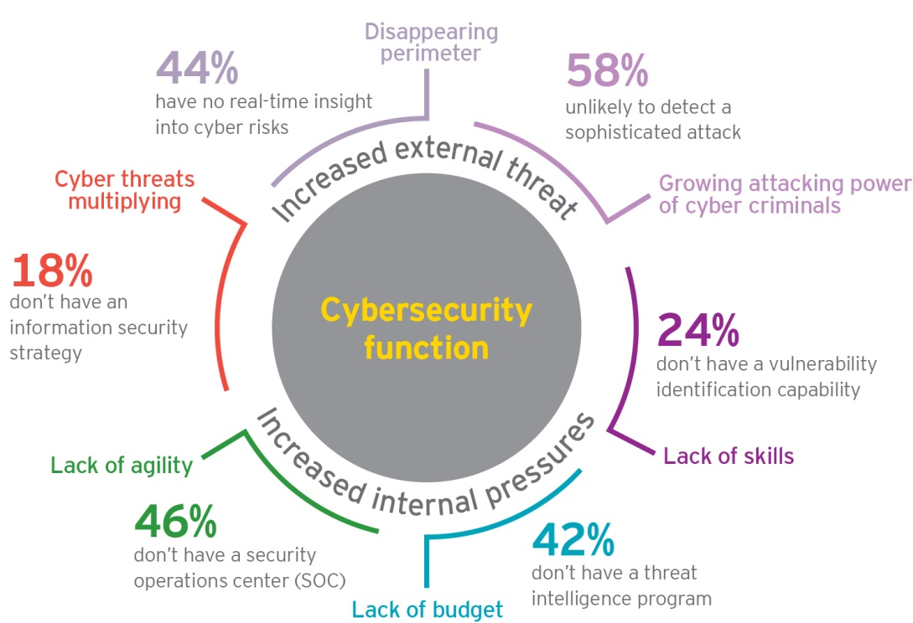
Las amenazas cibernéticas crecen de forma rápida y extensiva
Notes:
Above stats are all from the Global Information Security Survey, which showed a real lack of focus of time / budget on cyber in the mining and metals sector
42% do not have a threat intelligence program, and a further 35% only have an informal program, meaning ¾ of respondents unprepared to proactively identify and manage cyber risks

Slide 37
Los tres desafíos principales de ciberseguridad
La convergencia de IT y OT
Sub-inversión histórica y restriccion de presupuestos bajo la realidad actual
La mayoría de las organizaciones han sido “ hackeadas”, pero no necesariamente lo saben
Los ataques cibernéticos son un tema en todo el sector, independiente del tamaño o severidad.
Los hackers pueden ser ONGs, grupos ambientales, o comunidades que buscan servir sus motivos potenciales
Notes:
Convergence of IT/OT – has opened more gateways to hackers. OT traditionally not managed with the level of risk management and security controls of IT and the skill sets to manage them are different
Underinvestment – Sector only addressing top 1 or 2 critical issues due to budget restrictions – so have limited ability to keep pace with cyber threats. If you are not advancing you are standing still. Given the historical management of OT security and IT security have been separate, likely duplication of spend and resourcing
Understanding of whether a breach has occurred – in many cases, breaches are identified much later than the breach has occurred – and with 58% saying they are unlikely to detect a sophisticated attack, this is a real challenge

Slide 38
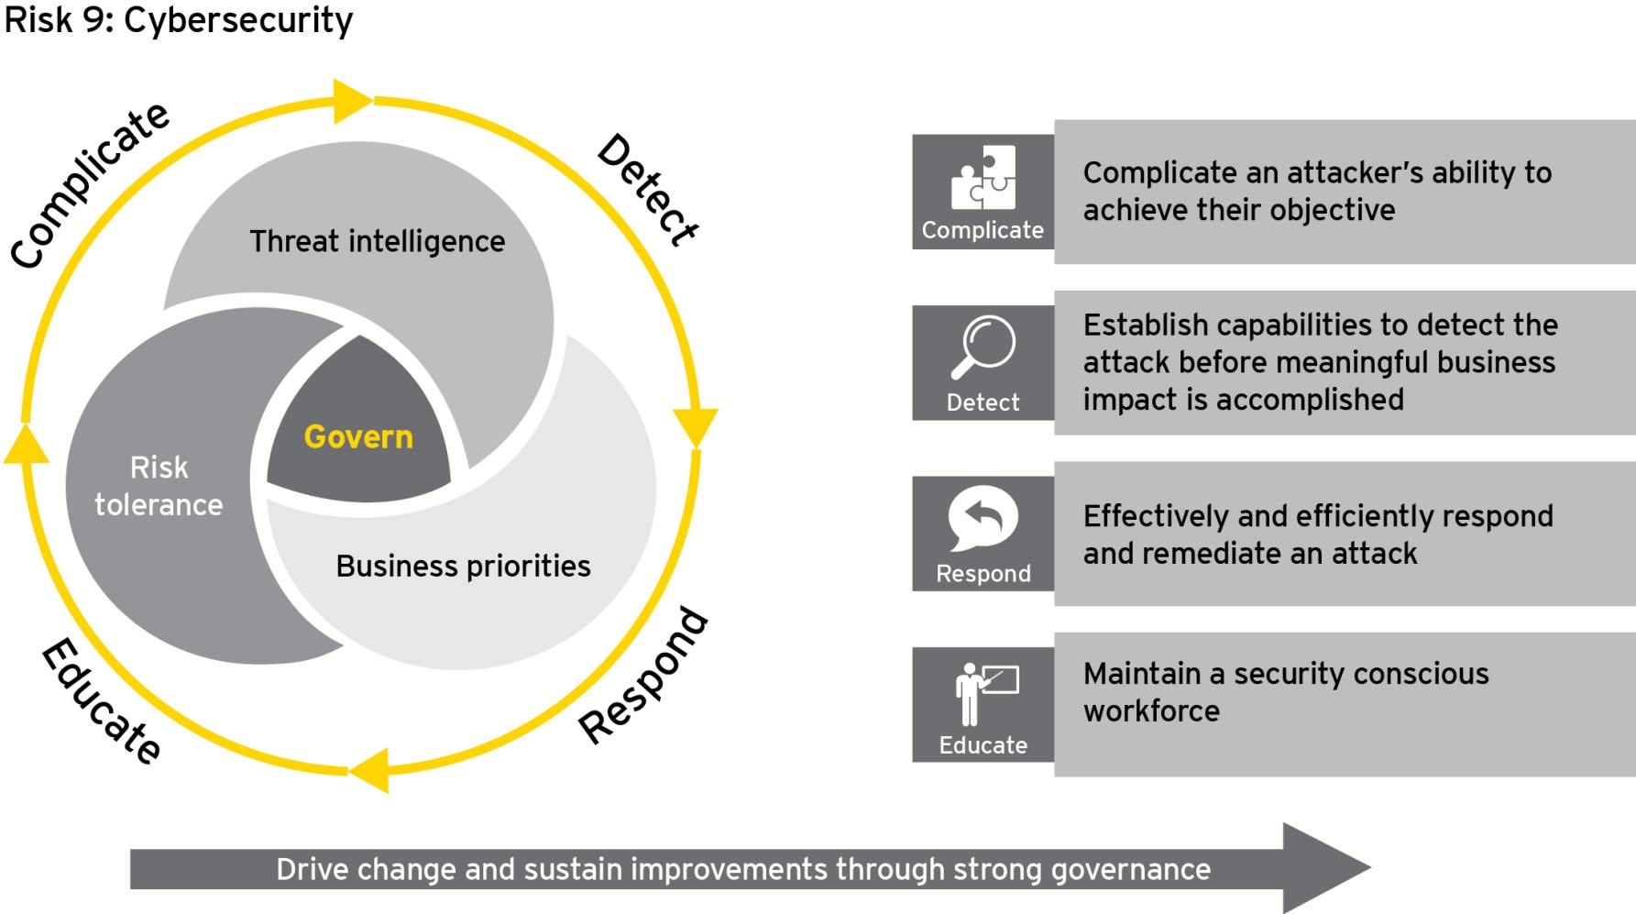
No se trata sólo de sistemas
La seguridad informatica y operacional tiene que ser una prioridad del directorio y tiene que ser administrado desde arriba hacia abajo
June 2015
Business risks facing mining & metals 2015-16
Notes:
Cyber security needs to be on the corporate risk register and integrated into ERP. Not just about systems – people processes and technology capabilities need to be observed.

Slide 39
10. Innovación

Slide 40
La inovación será clave para el futuro del sector
Encuesta de ejecutivos globales de minería
…identificaron que la inovación tiene un papel clave en la productividad de minería en los próximos 15 años
230 ejecutivos con 70%
C-Level
Áreas con el mayor impacto de inovación
1
Automatización
Reducción del consumo de energía
Extracción de recursos
Data and análisis
Procedimiento/tratamiento
2
3
4
A lo largo de 6
continentes
5
… y abordará los temas estructurales de la industria a largo plazo
Tendencias con un impacto significativo de inovación
1
Disminución de los grados de cuerpo mineral
Aumento de minería en lugares difíciles
Costos de energía y disponibilidad
Aumento de complejidad operacional
100+ compañías
2
3
4
June 2015
Business risks facing mining & metals 2015-16
Notes:
The survey was undertaken by VCI (via the University of Queensland)
The benefits are clear – whoever gets this right can improve their position on the cost curve, relative to competitors

Slide 41
Compañías existosas
Alinean su programa de inovación a la estrategia
Tienen la estructura, sistemas, y procesos correctos
No se enfocan solo en tecnologia
Aplican gestión de cambio comprensivo
Colaboran
El foco en inovación es a largo plazo
Notes:
To achieve success in innovation, the most important pre-condition that needs to be in place is to ensure that a company is one that fosters innovation. Successful companies:
Align their innovation program to strategy: success requires ownership and tone from the CEO down. A clear vision and roadmap needs to be developed and communicated across the organization. For innovation to succeed, companies need to reward value creation (not just cost cutting) and hence have the right incentives and metrics in place for this, as well as a clearly defined budget for innovation.
Have the right structure, systems and processes in place: innovation tends to be hampered not by a lack of ideas, but by poor execution. Companies need to implement a process to facilitate and empower innovation, whereby successes and early failures are celebrated. To get the structure right may mean a structural change to enable much-needed cross-functional collaboration (which we discovered was lacking in our recent report Productivity in mining – now comes the hard part).
Undertake comprehensive change management: innovation is a people issue. A report by Harvard Business Review found that technology adoption alone, without the accompanying changes in work practices, has little or even a negative impact on productivity. Too often innovation implementation fails due to an ineffective change management program.
Collaboration is key to success: From other sectors, it has been proven that increasing collaboration will catalyze innovation, and also brings the benefit of cost-sharing and de-risking. There have been some successful examples of the mining and metals sector collaboration with other industries and with academia, but on the whole mining and metals organizations have often left innovation to the mining equipment, technology and services (METS) sector. R&D is not seen as a core competency of mining but short-term problem solving is. However, organizations are reluctant to give small METS companies an opportunity until innovation is proven. Procurement processes also block innovation small suppliers from access via pre-qualification.
Long term focus: shouldn’t be a driver for short term bottom line improvements, but rather to maximise long term returns

